Slide 1
Docker Enterprise
Steven Follis
Solutions Engineer
Docker Inc.

Slide 2
Today
Time | Description
09:00 - 10:30 | Presentation: Overview of the Docker Enterprise Platform
10:30 - 12:00 | Lab 01: Provisioning the Docker Enterprise Platform in Azure This lab uses the Docker Certified Infrastructure (DCI) project to first provision and then configure all necessary Azure resources for a highly-available Docker Enterprise environment.
12:00 - 01:30 | Lab 02: Deploying Multi-OS applications with Docker Enterprise In this lab we will use a Docker Enterprise cluster to deploy both a Java web app on Linux and a multi-service application that includes both Windows and Linux components using Docker Swarm. Then we'll take a look at securing and scaling the application. Finally, we will then deploy the same app using Kubernetes.
01:30 - 03:00 | Lab 03: Containerizing a .NET Application This hands-on lab shows you how to take an existing ASP.NET WebForms app, run it in Docker and then modernize the app by breaking features out and running them in separate containers.

Slide 3
Today
Using Containers
The Docker Enterprise Platform
Docker + Azure

Slide 4


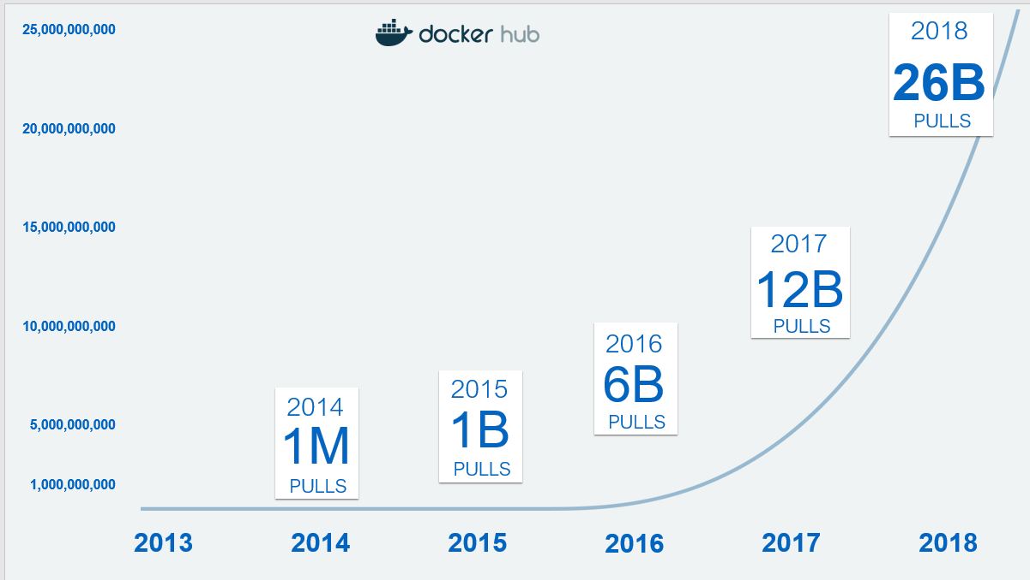

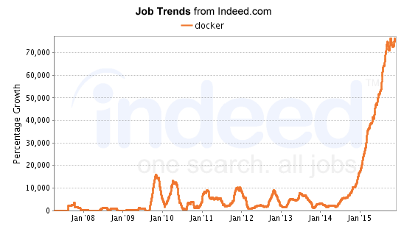
Containers are the “Fastest Growing Cloud Enabling Technology”
By 2020, more than 50% of global organizations will be running containers in production.
-Gartner
Title source: 451 Research
Notes:
Main Point:
Docker transformed the container landscape and made it mainstream, it’s now the most widely used container technology globally.
Containers are here to stay and Docker is the clearest container bet by far
Speaker notes:
Just how accessible? Well, it's been described as the most successful platform every launched. The last count we had was over 12 billion downloads. That’s more downloads than there are people. That’s because the images are being downloaded onto servers and desktops, and devices and people keep coming back for updates. That last point in itself is telling. Whatever people’s initial reason for using Docker was it has continued to serve them well. In fact what we’re seeing is that the initial users were developers for their ease of use but enterprises have adopted Docker containers for many more reasons than that in the last few years and we’ll be covering that in more detail as we proceed.
The second graph shows the growth in job postings requiring Docker skills. So what does that tell us? Well, for one, it’s probably a good skill to have on your resume if you’re in iT but far more importantly, if you thought this was a fringe technology used on weekends by enthusiasts think again. These are real jobs posted by enterprises of all sizes to bring Docker skills into their IT organizations.
So the real point of this slide is to make clear that this even though you may have only recently heard of it, application containers are a mature, stable technology.
...And Docker who made container technology accessible has taken IT by storm and shows no sign of slowing down. Docker Containers are here to stay and are the most widely used and recognized container technology globally.

Slide 5
Docker and Microsoft Have a Long Partnership Driving Windows Containers
Oct 2014:
Joint engineering with Microsoft begins
Sep 2016: Windows Server includes Docker Engine - Enterprise
Mar 2017:
Docker announces “Modernize Traditional Apps” program with Microsoft as key partner
Aug 2017:
Docker Enterprise supports mixed Windows and Linux clusters
Coming Soon!
Docker Enterprise supports Kubernetes with Windows Server
Docker and Microsoft have a joint engineering and support relationship
Designed to keep consistency across Windows and Linux applications
Docker continues to drive innovation and adoption of Windows containers in collaboration with Microsoft

Slide 6
Use Cases for Containers

Slide 7
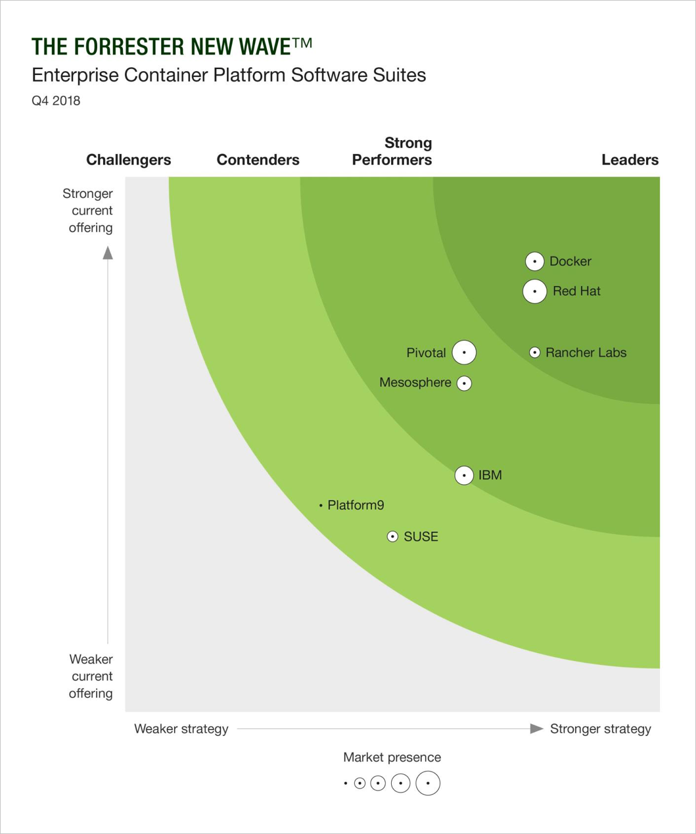
Docker Enterprise “leads the pack” in Forrester New Wave™: Enterprise Container Platform report
A Leader: Docker named a leader among seven other vendors in the Enterprise Container Platform market
“Robust Container Platform”: Docker Enterprise Platform received a differentiated rating, the highest rating possible, in eight criteria - including runtime and orchestration, security features, image management, user experience, integration and APIs, vision and more
Customer Reference Summary: Docker’s customers highlight end to end image security, support for Windows and support expertise, also stating that “Docker Enterprise makes working with containers easy.”
Forrester’s Assessment: Docker “leads the pack with a robust container platform well-suited for the enterprise.”
The Forrester Wave™ is copyrighted by Forrester Research, Inc. Forrester and Forrester Wave™ are trademarks of Forrester Research, Inc. The Forrester Wave™ is a graphical representation of Forrester's call on a market and is plotted using a detailed spreadsheet with exposed scores, weightings, and comments. Forrester does not endorse any vendor, product, or service depicted in the Forrester Wave™. Information is based on best available resources. Opinions reflect judgment at the time and are subject to change.

Slide 8
Docker Enterprise:
Any App, Any Infrastructure – One Platform
Traditional
Microservices
Edge & IoT
ISV
Big Data ML & AI
Blockchain
Serverless
Docker Enterprise
Mainframe
Cloud
VM
Bare
Metal
Edge
Device
Notes:
Choice of …
Any application
Any infrastructure

Slide 9
Why Docker Enterprise for MTA?
Complete Solution
Broadest App Support
Enable Hybrid & Multi-Cloud
There is a learning curve with containers and not all organizations can do it alone
Nature of legacy apps cover a wide range of applications, adopted over time
Many organizations leverage containers to add portability to existing apps
We have a mature methodology that includes tools, training, and services to help you with your MTA projects, and partners to help you get started with our MTA program.
The only platform that supports Linux, Windows, and mainframe in the same environment.
Docker works with all different clouds and infrastructure platforms to prevent lock-in.

Slide 10
Why Docker Enterprise for Microservices?
Orchestrator Choice
Managing at Scale
Operational Complexity
More objects to manage, need for independent scaling, self-healing.
Number of images per app increases; need a solution for automating and securing images at scale.
Microservices inherently mean more objects for Ops teams to manage.
Support both Swarm and Kubernetes interchangeably to support different apps on the same infrastructure. Use best orchestrator for the need.
Policy-based image promotions, signing and scanning all help to manage thousands of images and repositories.
Highly scalable operating model for all containers across Linux, Windows; simplified ops workflows and ability to support multi-tenancy

Slide 11
Why Docker Enterprise for DevOps?
Security
One Operating Model
No Lock-In
As pace of increases, more apps are being deployed more often. Orgs want a way to control or enforce what is deployed.
Enterprise orgs have a lot of diversity in apps and platforms, need a scalable way to manage and grow.
PaaS options have strong integration to dev processes, but often called “opinionated”
Docker Secure Supply Chain including Docker Content Trust, image vulnerability scanning, secrets management, easily integrated to CI/CD pipeline
Different app types (Windows, Linux, monoliths, microservices) and infrastructure platforms share a common operating model
In comparison to PaaS approach, users can integrate with their choice of tooling without fear of lock-in, can change integrations as needed.

Slide 12
Why Docker Enterprise for Cloud Migration?
No Lock-In
Common Management
Security
Other platforms lock you in with limited OS support or being only cloud-based.
While containers are portable, managing containers is not.
Enterprise orgs want integrated security that protects and secures across entire software lifecycle.
Docker runs on multiple Linux distributions and Windows Server, can be deployed on any infrastructure.
Organizations get a consistent operating model where containers are sourced from the same registry, the same policies can be applied to any infrastructure,
Docker Secure Supply Chain including Docker Content Trust, image vulnerability scanning, secrets management.

Slide 13
Why Docker Enterprise for Edge Computing?
Agile Software Development
Secure Software Distribution
Lightweight Applications
Rapidly changing sensors/ devices and data push need for sophisticated edge apps.
Edge sites are widely distributed and sometimes inaccessible.
Edge servers need to be energy efficient and compact.
Accelerate software development with CI/CD pipelines and support rapid testing and deployment.
Policy-based image promotions, signing and scanning all help to securely distribute content to edge locations
Small attack surface and greater isolation drive higher server efficiency

Slide 14
The Docker Enterprise Platform

Slide 15


The Docker Family Tree
Subscription-based, commercially supported products for delivering a secure software supply chain
Enterprise Edition
Intended for:
Production deployments + Enterprise customers
Open source framework for assembling core components that make a container platform
Free, community-supported product for delivering a container solution
Intended for:
Open source contributors + ecosystem partners
Community Edition
Intended for:
Developers and small teams
Software dev & test
Notes:
The Docker container technology started as an open source solution which is now called the Moby Project. The Moby Project has thousands of contributors and is an active community that includes employees from Docker, ecosystem partners, as well as strong contributions from unaffiliated individuals.
From the Moby project, Docker delivers two products. Docker Enterprise Edition is a set of commercially-supported, subscription-based products intended for production deployments and Enterprise customers. And Docker Community Edition which is a free, community-supported product.
The Moby Project

Slide 16
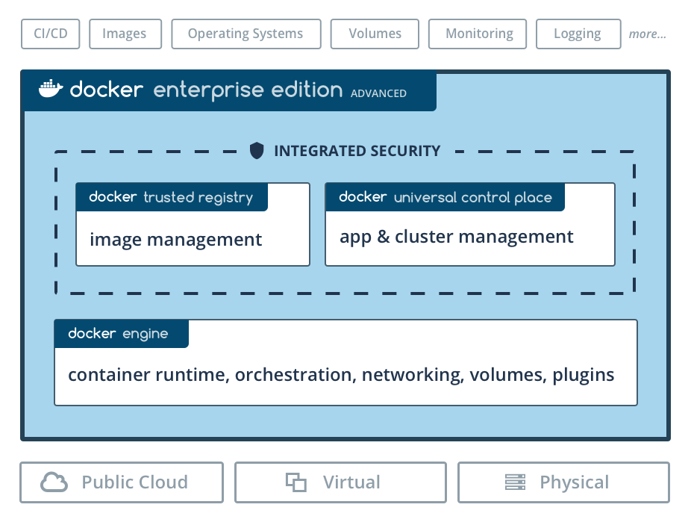
Docker Enterprise Edition Platform
24 x 7 x 365 Support
Docker Certified Program
Kubernetes + Swarm
RBAC with Active Directory

Slide 17
Only Docker Delivers All Three Core Enterprise Requirements
Three Core Enterprise Requirements Drive Docker EE Design
Choice
Security
Agility
Your app in any cloud, including Hybrid
No lock-in
Risk mitigation
Use Docker native tools … or almost any you prefer
Governance
Chain of custody
Role-based access control
Threat scanning
Standardized and unified operations
Dev to Ops consistency
Rapid Delivery and response
Cost efficiency
Notes:
Main Points: This is a “Why?” Slide
When Docker built the Enterprise Edition platform we had these three objectives in mind as design goals.
All 3: Freedom of Choice, Security (peace of mind) and Operational Agility without compromise
Having all 3 at once is what enterprises need and what differentiates Docker from other platforms
EE will incorporate any emerging technologies delivered as a container too (eg serverless, IoT etc) so its also an investment in the future
We built a Container Platform that captures everything we've learned over 5 years and countless customer engagements. The Docker EE platform balances Choice, Security and Agility simultaneously.
Freedom of choice is critical: Deploy on Cloud, on-premise or Hybrid. Linux or Windows. Docker native or 3rd party tools. It's entirely up to you. Existing or greenfield apps. No other containerization approach can say this. Modernize at your pace not ours.
It's secure. There are so many features built into this. But the key is secure control of your environment and the ability to audit every step in the process. Docker containers are more secure than other approach with, arguably, the smallest footprint for attack vectors out there. Gartner and others have acknowledged this.
And in a changing world, Agility is key. Standardization means speed and savings. Faster development. Faster testing. Easier, faster scalability. As IT is more and more a driver of competitiveness, Dockerized applications are the path to being more responsive and delivering value to employees and customers sooner. And because of Docker extensibility, you’ve got a future-proof system designed to let you adopt new technologies in the future.
There are other alternatives out there. There are PaaS alternatives. There are cloud-based container solutions out there. None of those bring these three elements together in a balanced way. No other is as adaptable to your existing governance models. No other is as capable of running on almost any platform and none is as lightweight.
Furthermore this adaptability makes it the platform of choice for emerging technologies too. Wherther that’s serverless or something else, containers can support them and EE prevents enterprises from getting locked-in to any particular version.

Slide 18
Docker EE Architecture
Add-ons
Manager Nodes
Logging
Monitoring
Load Balancer (ucp.contoso.com)
LDAP/AD
External CA
Image storage
Node
Node
Node
UCP manager
UCP manager
UCP manager
Worker Nodes
DTR Nodes
Load Balancer (*.apps.contoso.com)
Load Balancer (dtr.contoso.com)
Node
Node
Node
Node
Node
Node
UCP worker
UCP worker
UCP worker
DTR worker
DTR worker
DTR worker
DTR Storage (Azure Storage, NFS, etc.)

Slide 19
Engine Comparison
Community Edition | Enterprise Edition
Community-based support forums | Enterprise-class support with defined SLAs and private support channels
7 months of software maintenance | 24 months of extended software maintenance
Hotfixes & patches only for most recent release | Hotfixes & patches for all supported releases
 | FIPS 140-2 validated encryption modules
 | Enforcement of signed images
 | Ecosystem plugins and ISV containers certified

Slide 20
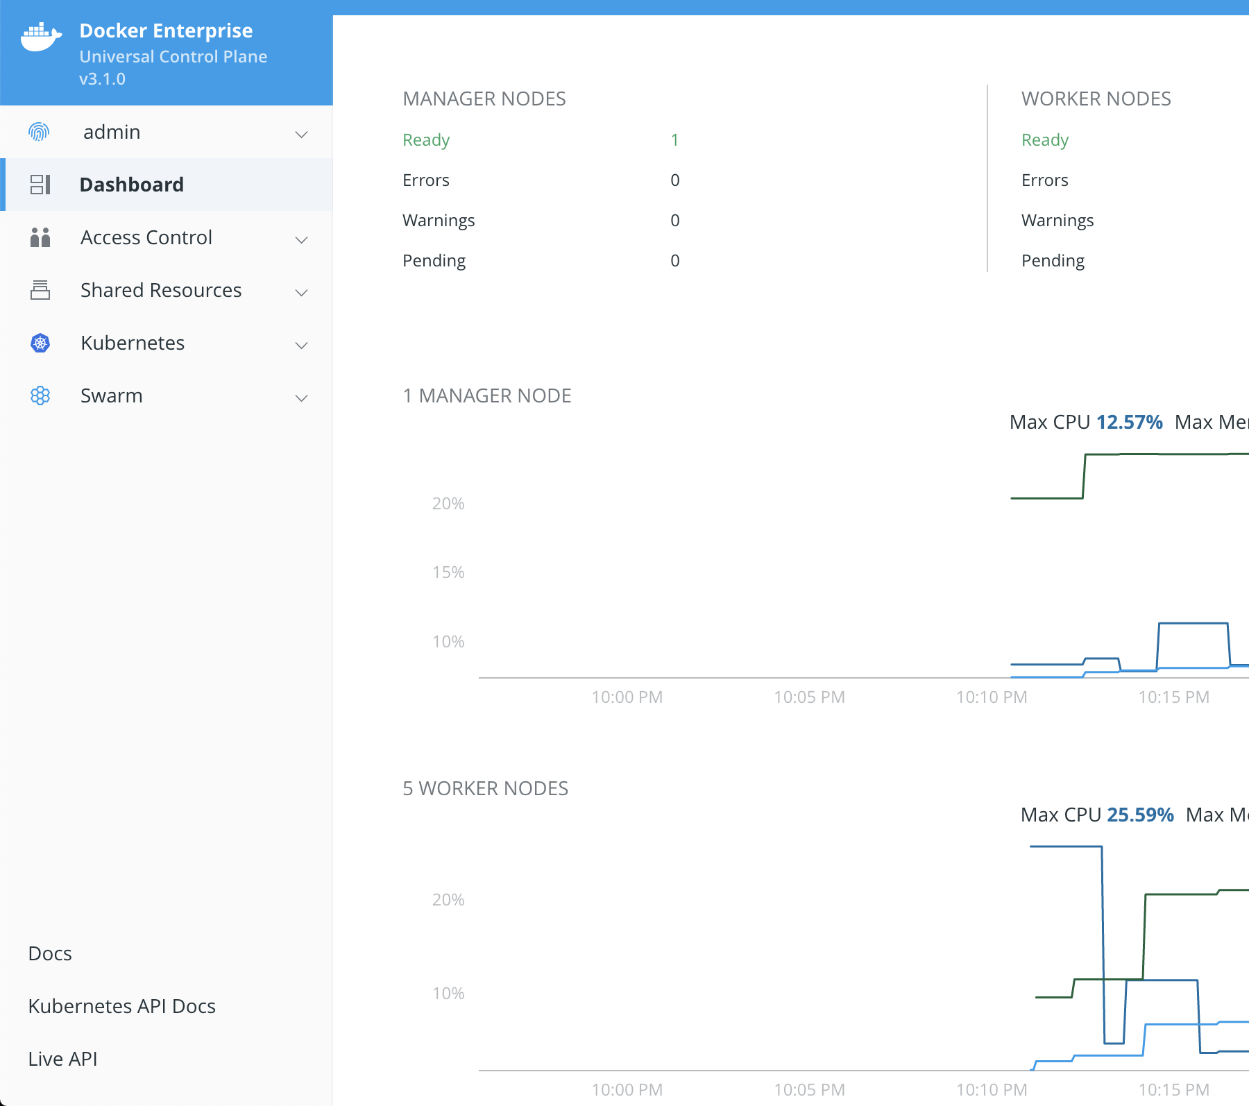
Universal Control Plane (UCP)
Simplifies cluster installation and operation
Richer experience than k8s Dashboard, Portainer, etc.
Implements identity and governance policies for the cluster
Provides choice of two orchestrators

Slide 21
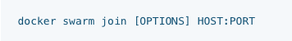


Streamlined cluster operations
KEY BENEFITS
Single command to join new Swarm/Kubernetes nodes into a secure cluster
Automatically integrate new nodes into existing access controls and policies
No need to install separate services; all nodes come pre-installed with necessary services
Docker EE Management Console
Docker EE Control Plane and
Cluster Management
Node
Node
Node
Node
Node
Swarm-mode cluster with Kubernetes-ready Linux nodes
Notes:
Single secure command to join nodes to the cluster to make scaling easy
Node is automatically ready to accept workloads all while using existing access controls and policies.
All nodes are Swarm and Kubernetes ready so you can switch nodes on the fly as needed depending on how your Swarm and K8S needs scale up or down

Slide 22
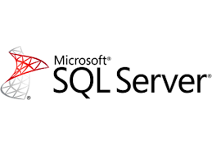
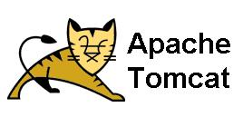

Interoperability across Linux and Windows
App-Net:
10.0.0.0/24
10.0.0.1
10.0.0.2
Node
Node
Node
Node
Worker
Worker
Worker
Worker
Worker Nodes
Leverage best-in-class technologies across Windows and Linux
Connect Windows and Linux containers in the same cluster through a common overlay network
Build Compose files for hybrid applications
Leverage labels and constraints for intelligent placement and scheduling
Notes:
Only platform today that can run both Windows and Linux in the same cluster or platform.
DISCOVERY:
What windows do you have in your env?
What linux do you have in your env?
What versions?
What types of apps?
You don’t need separate clusters based on OS.

Slide 23
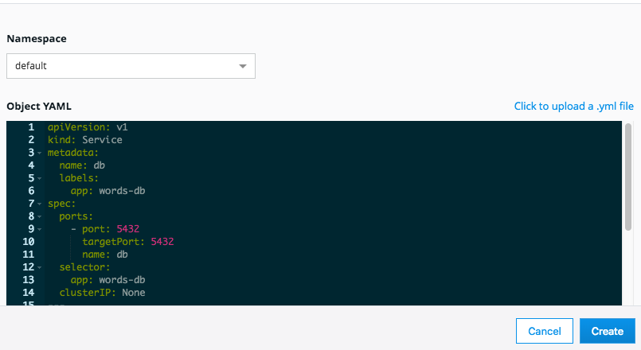
Deploy Applications via GUI or CLI
CHOICE
Docker EE offers an easy to use GUI to deploy Swarm services and Kube deployments
Can also connect local client (docker/kubectl) to UCP API with user certificates and run commands
Both methods enforce permissions and limit unauthorized access
Notes:
Find in my time, two types of ppl. Ppl who like GUI, ppl who like CLI.
What I found, in a given team there isn’t uniformity. Some folks like CLI and text files. But managers like to see visual reports and access a GUI.
Everything you do in the CLI, you can do in the GUI.
Devs can use CLI, but managers can use the UI to make some changes as needed.
Anecdote [if needed]: This really resonated at Este Lauder – couple of managers in the room, “yes, this is really important. it’s not one or the other”.
If you want to automate things, there’s an API.
Swagger based API, in GUI, go look at the API and and test it out; see the JSON output.
DISCOVERY:
How do you deploy apps today? Sophisticated compose files?
[if needed] if you run ‘docker version’, you have client AND server. how you apply docker client and attach to server in cluster. this is how you have the security and access controls that you care about.
[If needed] OpenShift is really convoluted, lots of CLI, not much GUI.

Slide 24
Container Orchestration
Operationalize multiple containers across a cluster of multiple nodes
Scheduling
Affinity/anti-affinity
Health monitoring
Failover
Scaling
Networking
Service discovery
Coordinated app upgrades

Slide 25
Container Orchestration
Operationalize multiple containers across a cluster of multiple nodes
I want to create 3 copies of a container on my cluster
Node
Node
Node
Node
Node

Slide 26
Container Orchestration
Operationalize multiple containers across a cluster of multiple nodes
Three containers are created and spread across the cluster
Node
Node
Node
Node
Node

Slide 27
Container Orchestration
Operationalize multiple containers across a cluster of multiple nodes
One node crashes, impacting the container
Node
Node
Node
Node
Node

Slide 28
Container Orchestration
Operationalize multiple containers across a cluster of multiple nodes
Orchestrator re-creates a container on a healthy node to maintain 3 copies
Node
Node
Node
Node
Node

Slide 29
Choice of container orchestration
Docker Swarm
Quickly get started today with all workloads
Full Windows support
Kubernetes
Advanced capabilities with a broad community
v1.0 of Windows support has slipped to v1.14

Slide 30




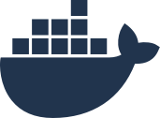

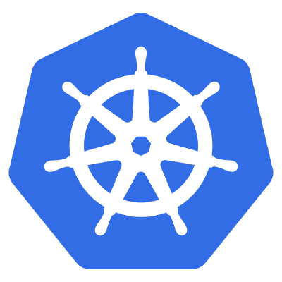
Choice of container orchestration
Run workloads side-by-side in same cluster, with same governance capabilities
Ops Team
.NET Dev Team
Using Swarm
Java Dev Team
Using Swarm
Java Dev Team using K8s
docker
enterprise edition
universal control plane
trusted registry
swarm mode cluster
Node
Node
Node
Node
Node
Node
Worker
Worker
Worker
Worker
Worker
Worker

Slide 31
Deploy Applications with Either Compose or Kubernetes YAML
FEATURE / CAPABILITY
Docker Compose
Kubernetes YAML
Use existing Docker Compose files and choose at runtime to deploy on either Swarm or Kubernetes
KEY BENEFITS
Simple Compose spec for developers, IT ops have multiple options for deployment
Migrate existing Docker apps to Kubernetes at your own pace
Node
Node
Node
Node
Notes:
really important.
DISCOVERY:
Are you aware of how to launch containerized apps?
Docker compose is an easy to read app definition that includes multiple tiers of the app to help you launch apps.
If the app and its multiple tiers has been written for docker compose, the yamls between swarm and k8s are an order of magnitude diff.
if initially you dev in swarm and want to move to k8s, you can make a runtime decision to change orchestrators and the platform translates that for you on the fly.
Familiar with k8s, fully supported k8s yaml but we made operating a k8s cluster easier to use.

Slide 32
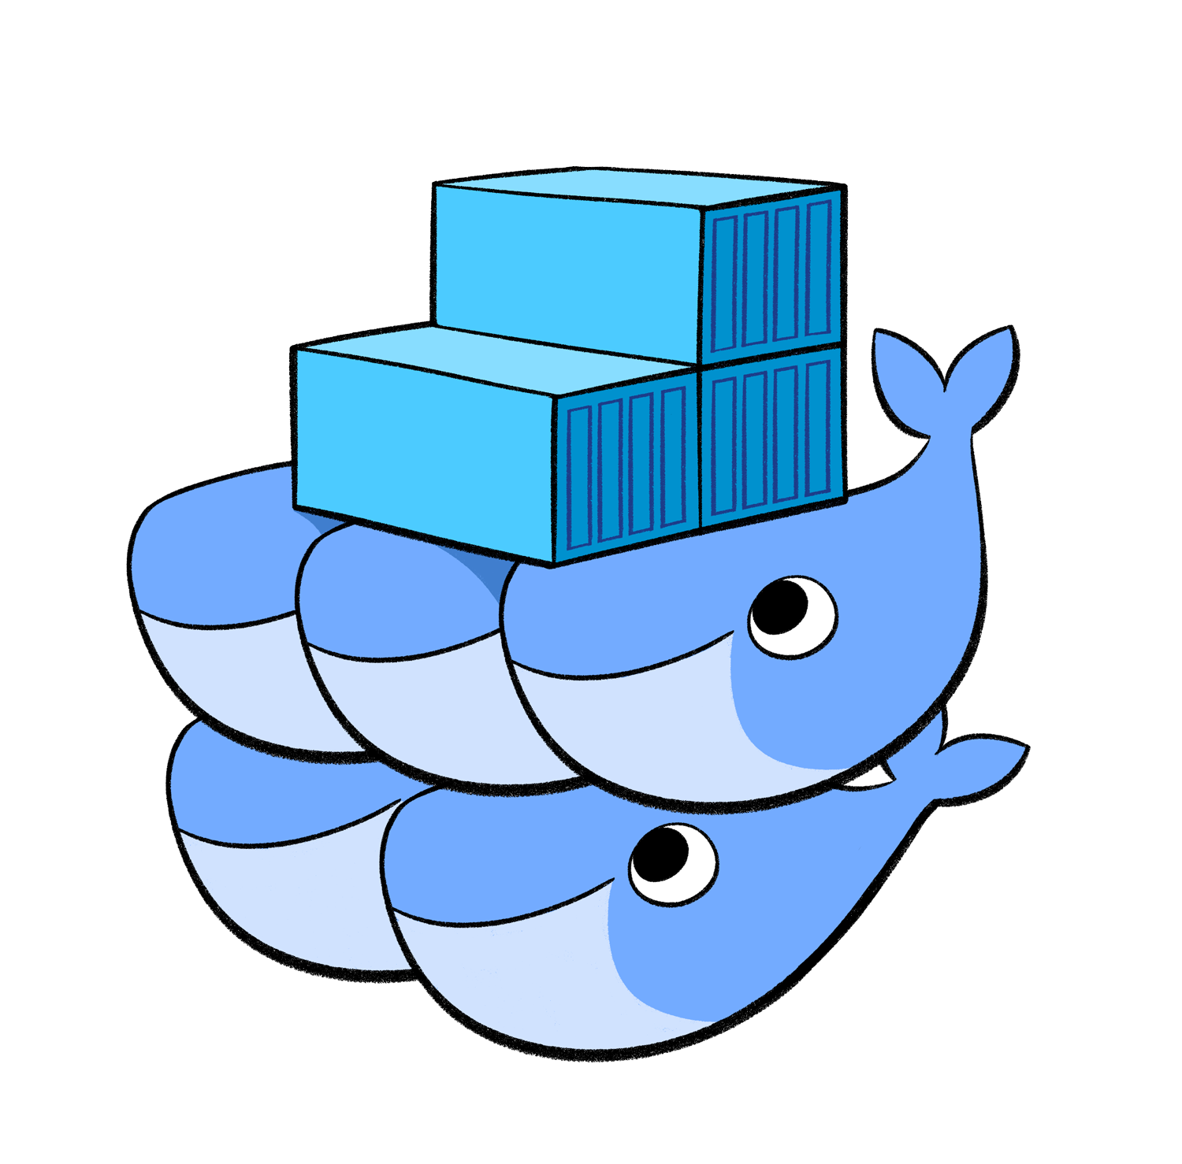
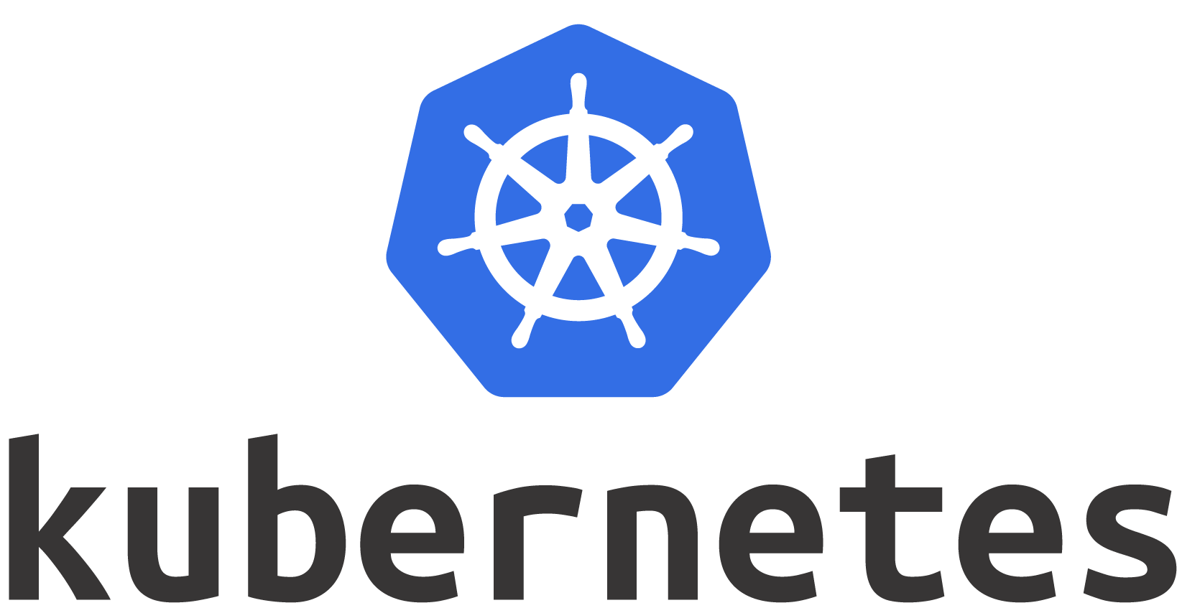


Flexible and Extensible Networking and Routing Options
Natively Integrated Networking
Service Discovery
Load Balancing
Layer 7 Routing | NGINX built-in, but swappable | NGINX built-in, but swappable
Docker Swarm
Notes:
Docker Enterprise includes the networking and routing options for how you publish your apps.
DISCOVERY:
What kind of LB do you have?

Slide 33
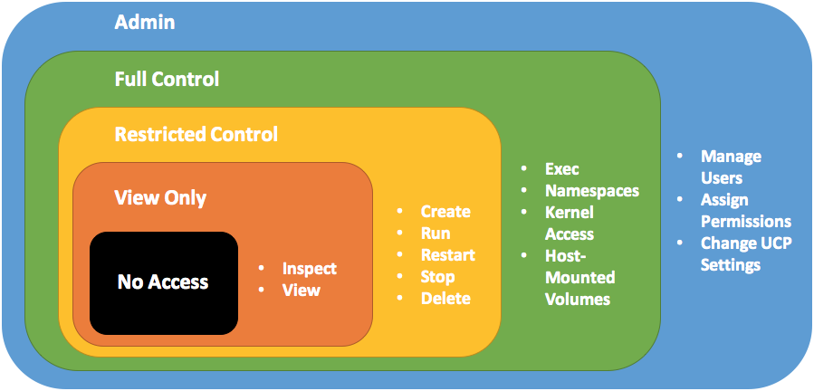
Operating with integrated role-based access controls (RBAC)
Assign permissions to existing Active Directory Security Groups
Convenient single sign-on for users
Use out-of-the-box roles, or create your own with custom permissions
Permissions enforced via labels placed on resources
Enforcement in-browser and on CLI

Slide 34
gMSA
Container
docker run
docker compose up
kubectl apply
Host Compute Service
SQL
LSASS Sets Identity
moby\AppA
Credential Spec
moby\AppA
Container Credential Guard
AD
Kerberos Tickets

Slide 35
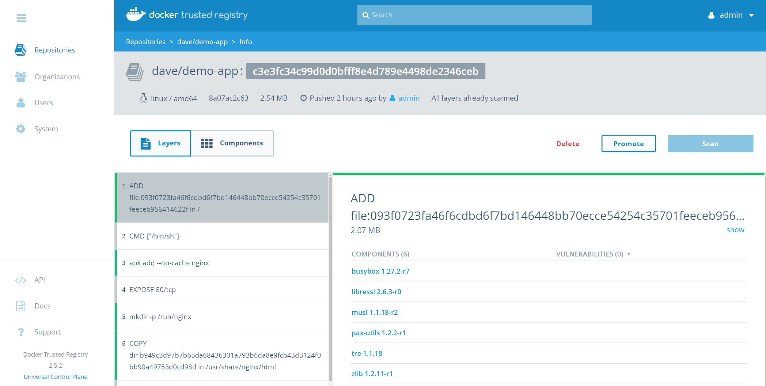
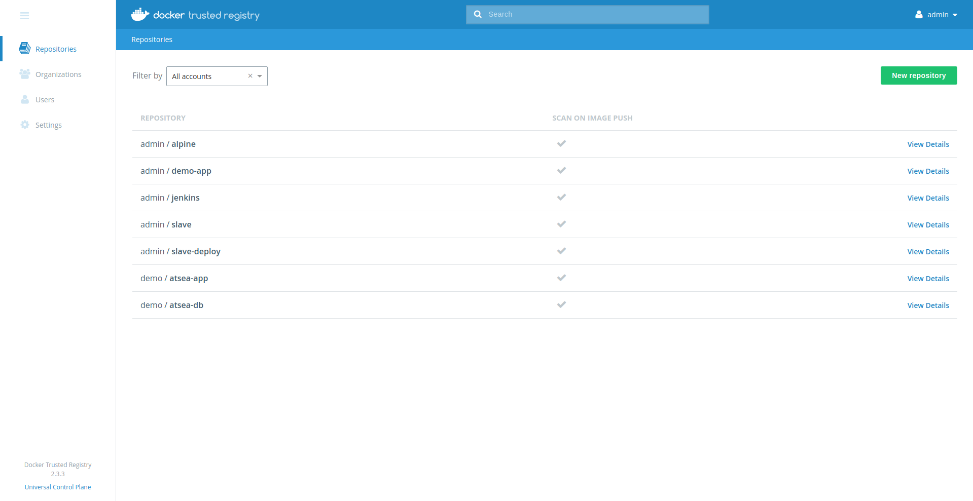
Docker Trusted Registry
The Industry Leading Enterprise Container Registry
Installed behind your firewall so that you can securely store and manage the Docker images you use in your production applications.
Deployed as part of the Docker Enterprise Edition Platform.
Ease of Use - Point and click UI to manage repos, images and team collaboration
Secure - Built in RBAC, Vulnerability Scanning and Image Signing.
High Availability - Resilient Multi-Node deployment. Including Image Mirroring and Distributed Image Caches.

Slide 36
Docker Trusted Registry
Accessible Securely Across Multiple Interfaces
All interfaces are secured by the Docker EE Universal Control Plane RBAC Engine. Providing a way to integrate permissions on top of your AD / LDAP Infrastructure.
$ docker push ....
$ docker pull ….
GET, PUT, POST to
https://dtr.example.com/api/
Web UI - Easy to use, interactive HTML5 Web UI accessible through your Web Browser.
Docker CLI - Integrates with existing developer workflows through the Docker CLI command structure.
REST API - Integratable and automatable through the HTTP REST endpoint. Documented through Interactive Swagger documentation.

Slide 37

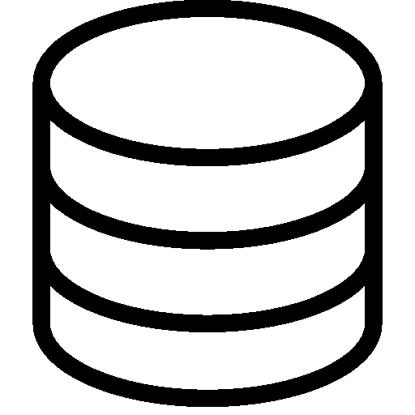

Role Based Access Control
Permissions Based Access to your Repositories
All interfaces are secured by the Docker EE Universal Control Plane RBAC Engine. Providing a way to integrate permissions on top of your AD / LDAP Infrastructure.
Each Image Repository, within DTR, has access granted on a User, Team or Organisation basis.
Permissions can be divided between Read-Only, Read-Write or Admin permissions per team per Repository.
The User database can be backed by Active Directory and LDAP integration environment, syncing your predefined organisational structure.
User interacts with DTR
DTR will check User Exists within Docker EE UCP
UCP populates User Database from AD / LDAP

Slide 38
Embedded Scanning Engine
Windows and Linux Images Scanned at a Binary Level
Docker Trusted Registry can scan images in your repositories to verify that they are free from known security vulnerabilities or exposures, using Docker Security Scanning. The results of these scans are reported for each image tag.
Ubuntu: openssl 2.1 Busybox 1.27
Apt install nginx: nginx: 1.12.2
Developer Pushes an Image to DTR
DTR will inventory a Docker Image on a layer by layer basis.
The Inventory is then compared to a local CVE Database
CMD ["nginx"]

Slide 39
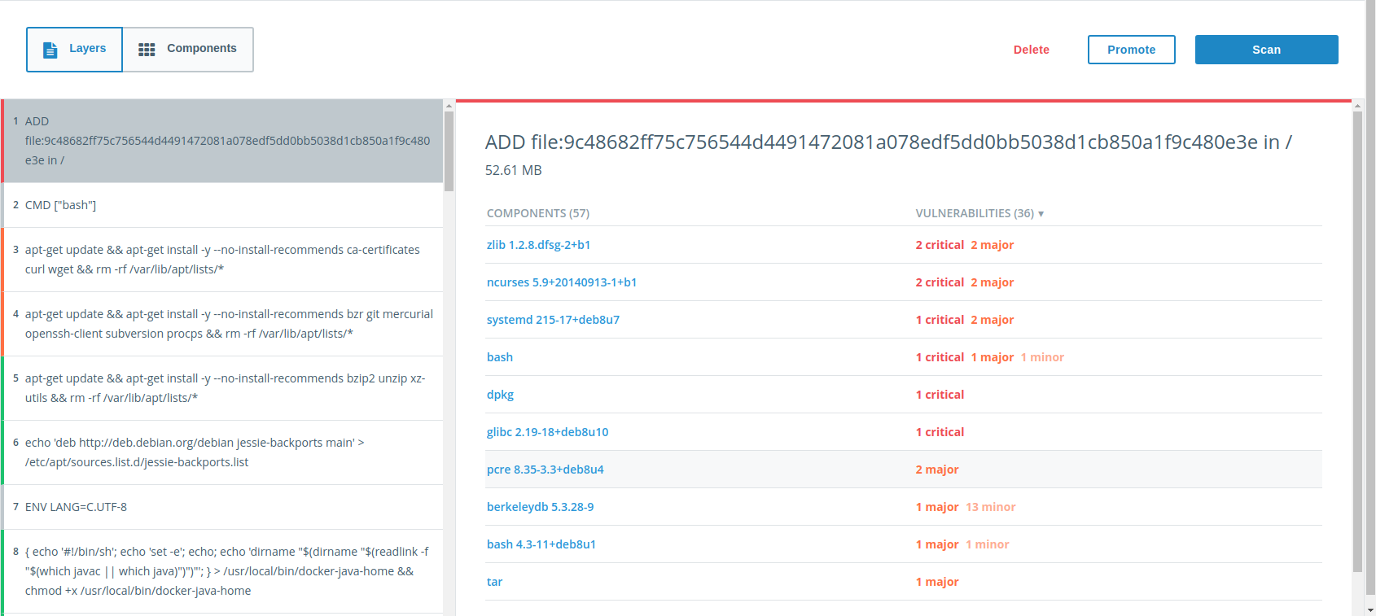
Embedded Scanning Engine
Windows and Linux Images Scanned at a Binary Level
Docker Trusted Registry can scan images in your repositories to verify that they are free from known security vulnerabilities or exposures, using Docker Security Scanning. The results of these scans are reported for each image tag.

Slide 40

Docker Content Trust
Ensure Image Integrity with Image Signing
You can configure the Docker CLI client to sign the images you push to DTR. This allows whoever pulls your image to validate if they are getting the image you created, or a forged one.
Define Image Signing Policies within your Docker EE Cluster’s, that enforce only approved content can run.
DTR will store all signed docker images and metadata, including signing keys and expiration dates.
Backend by the CNCF project Notary, a golang implementation of The Update Framework (TUF).
$ kubectl create -f exampleapp.yaml
Error from server (Forbidden): error when creating "exampleapp.yaml": pods "nginx" is forbidden: one or more container images do not meet the required signing policy: [nginx: image did not meet required signing policy]
$ docker run nginx:latest docker: Error response from daemon: image did not meet required signing policy.

Slide 41

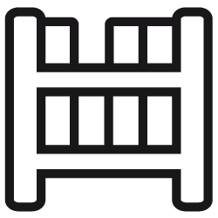
Docker Content Trust
Ensure Image Integrity with Image Signing
You can configure the Docker CLI client to sign the images you push to DTR. This allows whoever pulls your image to validate if they are getting the image you created, or a forged one.
User Builds or Pulls Docker Image
User Signs the Digest with RBAC Public Key
User Pushers Image (with signing data) to a Registry with a Notary Server
User Enables Content Trust on Cluster or Engine
Container Signing Metadata is checked against RBAC Engine Before Container Starts

Slide 42
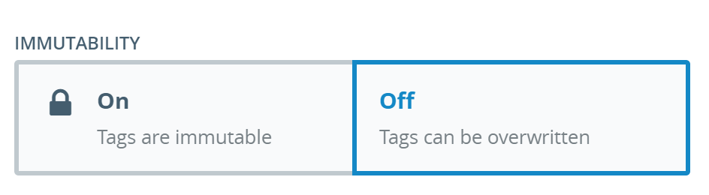
Immutable Image Tags
Ensure container images are versioned controlled and uniquely tagged
By default, a Docker Registry will allow its version number (tag) to be overwritten with new content if the version number already exists.
This is demonstrated all over the container ecosystem with the container tag “latest” being defined on community repositories.
Immutable Tags prevent a image tag to be uploaded to the same repository, if that image tag already exists. Forcing users to version containers images.

Slide 43

Integrating DTR with a CI/CD Pipeline
Building an Enterprise Secure Software Supply Chain
DTR’s can become the heart of your software supply chain, through its built in Image Promotion and Webhooks.
Easily Integratable with all major CI/CD tooling, and works out of the box with existing Docker Plugins.
You can ensure images have been:
Built through the pipeline
Scanned for vulnerabilities
Gone through QA
Signed ready for production
Image Uploaded to DTR
If Image has no vulnerabilities. Move to testing.
New Code Lands in Azure DevOps
ADO - Builds new Image from SCM
ADO Pipeline runs QA on the Image.
Security Team, sign off on image. Moves to Production.

Slide 44
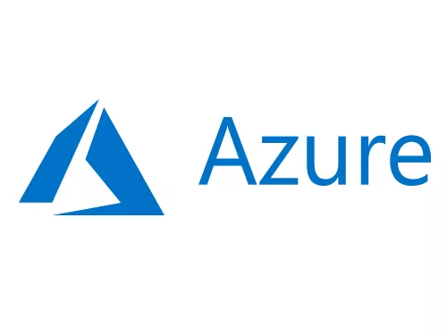
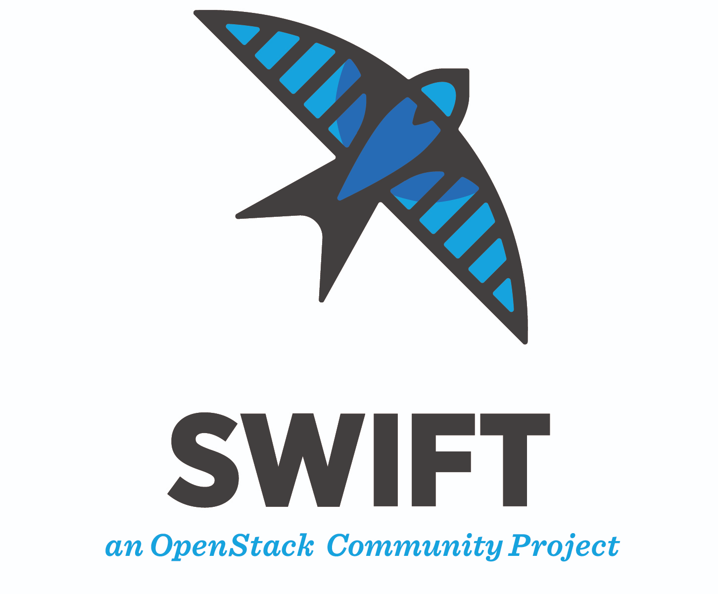
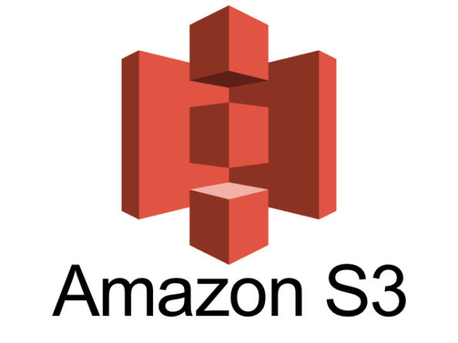
Docker Trusted Registry Shared Storage
Creating a Docker Trusted Registry Cluster with Shared Storage
To provide high availability for a Docker Trusted Registry, behind the underlying registry we sit a shared storage volume.
Docker Trusted Registry can be deployed in a Highly Available 3 or 5 node deployment.
The underlying image store of your Registry needs to be consistent on all nodes, so external storage is used. DTR Supports:
NFS
Amazon S3 or compatible
Google Cloud Storage
Microsoft Azure Blob storage
OpenStack Swift
NFS

Slide 45
Automated Image Mirroring (Replication)
Ensure High Availability with Image Mirroring
Docker Trusted Registry allows you to create mirroring policies for a repository. When an image gets pushed to a repository and meets a certain criteria, DTR automatically pushes it to repository in another DTR deployment or Docker Hub.
Docker Trusted Registry includes automated and manual image mirroring. Mirroring is defined on a per repository basis.
Automated Mirroring is defined through a mirroring policy. Mirroring policies include:
Tag Name
Component Name
No of Vulnerabilities
License Type
DTR will mirror the image to Site 2.
Site 1
Site 2
Image is pushed to site 1.
Image is available to be pulled on site 2.

Slide 46
Automated Image Mirroring (Polling)
Ensure High Availability with Image Mirroring
Docker Trusted Registry allows you to polling mirroring policies for a repository. Periodically DTR will search a secondary registry for new images, if it finds them, will mirror them locally.
Docker Trusted Registry includes automated image mirroring through polling.
On a per repository basis a primary DTR will poll a secondary DTR or the Docker Hub for new images. If a new image exists, it will mirror that image locally.
By default the polling window, is configured for a 15 minute window.
Note - The Feature is in Experimental
Docker Hub
Secondary DTR
Periodically the Primary DTR will look for new images.
Primary DTR

Slide 47
Image Caching
Deploy across Hybrid / Multi-Site environments with DTR Caches
Docker Trusted Registry can be configured to have one or more caches. This allows you to choose from which cache to pull images from for faster download times.
Docker Trusted Registry Caches can be deployed in Remote Clusters when a user wants to keep a centralised registry.
The first pull of an image on the 2nd site, will pull the image from the Primary registry, through the Cache. All subsequent pulls will be from the Cache.
All Pushes must go to the Primary Registry.
Caches are defined on a per User basis.
Primary DTR
DTR Cache
Site 1
Site 2
$ docker pull

Slide 48
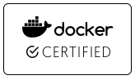
Docker Secure Supply Chain
DEVELOPERS
IT OPERATIONS
Microservices
Security scan & sign
Image Registry
Control Plane
Traditional
docker store
Third Party

Slide 49
Docker Enterprise on Azure

Slide 50


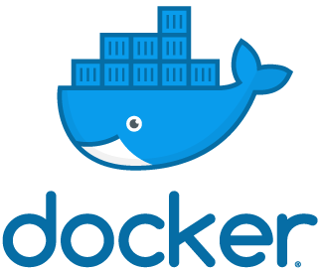



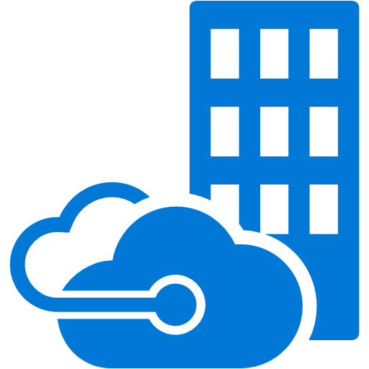

Integrating Docker EE with Azure Services
Blending containers with managed services for flexibility and efficiency
Azure Storage
Azure SQL Database
Visual Studio Team Services
Application Insights
Azure CosmosDB
Log Analytics
Azure Stack

Slide 51
Docker Certified Infrastructure Architecture

Slide 52
Docker Certified Infrastructure Architecture

Slide 53
Integrating Docker and Azure DevOps
Visual Studio Marketplace
Pre-built Docker add-in
Click to add to your tenant
Appears in Edit Pipeline screen as actions
Terminals
Can always use Bash, PowerShell, etc. within pipelines
Gives ultimate control over build steps
Azure Services
Key Vault
Storage

Slide 54
Build Agents
Servers designated to execute build and release pipelines
Multiple servers pooled together for parallel builds
Traditionally virtual machines, but containers provide additional flexibility
Allows control over exact SDKs, frameworks, etc.

Slide 55
Integrating DTR with a CI/CD Pipeline
Building an Enterprise Secure Software Supply Chain
DTR’s can become the heart of your software supply chain, through its built in Image Promotion and Webhooks.
Easily Integratable with all major CI/CD tooling, and works out of the box with existing Docker Plugins.
You can ensure images have been:
Built through the pipeline
Scanned for vulnerabilities
Gone through QA
Signed ready for production
Image Uploaded to DTR
If Image has no vulnerabilities. Move to testing.
New Code Lands in Azure DevOps
ADO - Builds new Image from SCM
ADO Pipeline runs QA on the Image.
Security Team, sign off on image. Moves to Production.

Slide 56
When to Lead With Docker Enterprise
Shorter learning curve = faster route to ACR
Customer has a hybrid environment including Windows workloads.
 | Java/Linux Workloads | Windows Workloads | On-prem | Hybrid / Multi-Cloud | Speed / Complexity
Docker EE | ü | ü | ü (incl. AzureStack) | ü | Fastest path to ACR Simple for legacy apps Best security Swarm & Kubernetes
ACS / AKS | ü | ACS/Swarm ü AKS û | û | û | Best for 100% Azure customers & advanced Kubernetes users
RedHat | ü | û | ü | ü | Toolkit approach – flexible Non-standard Kubernetes
Pivotal | ü | û | ü | ü | Powerful but complex – refactoring required
Notes:
Main Points:
Kubernetes in any form (including AKS) does not yet support Windows workloads. Your best bet is to containerize Windows workloads using Docker Swarm orchestration today, and we make it easy and seamless to switch to Kubernetes when/if windows support is available.

Slide 57


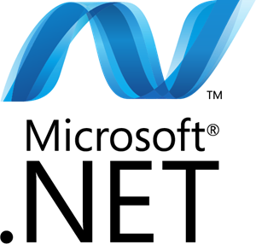
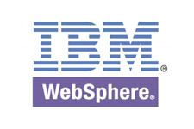
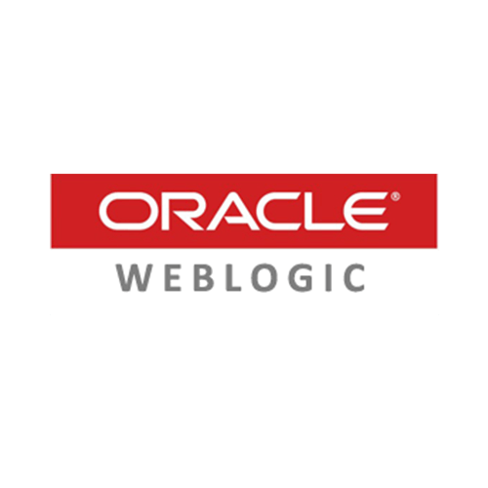

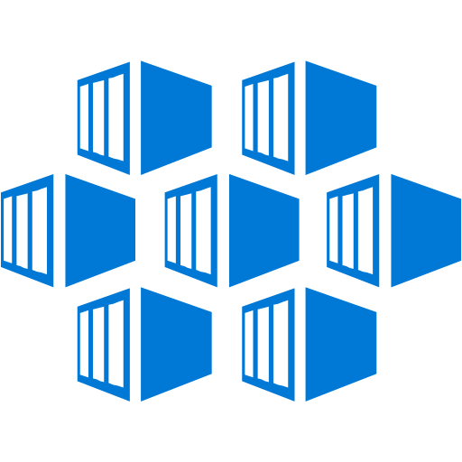
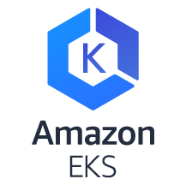
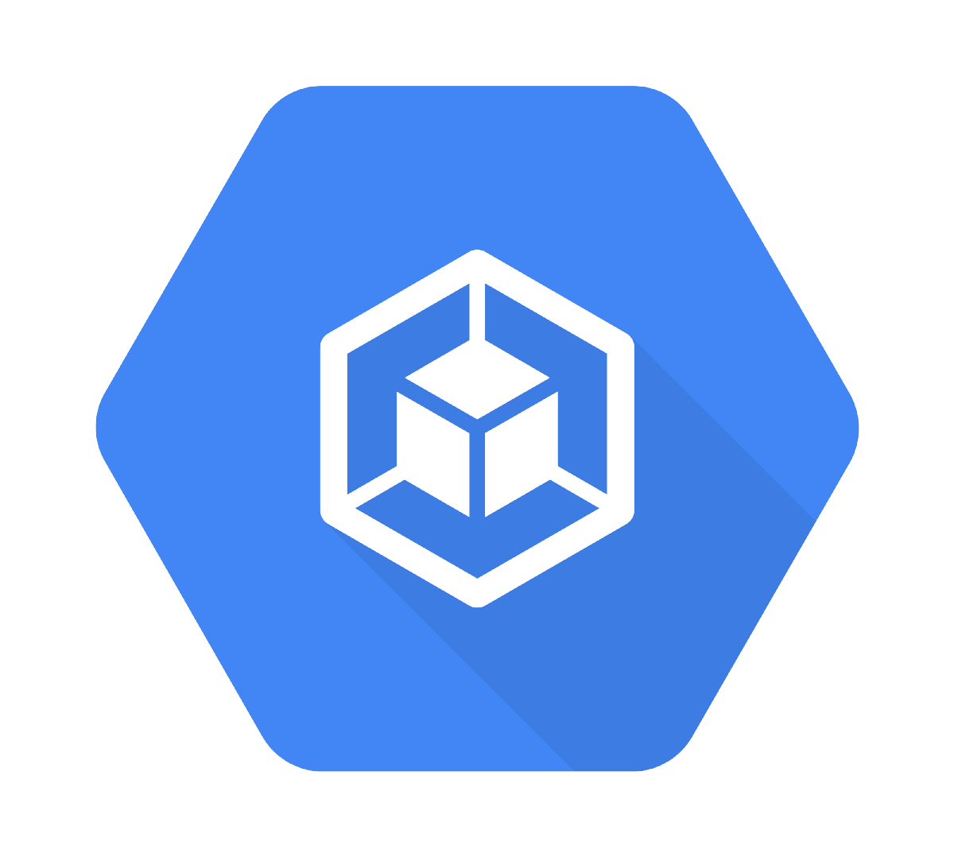
Introducing Federated Application Management Across Hybrid/Multi-cloud Infrastructure
Federated Application Management
Only Enterprise-Ready Container Platform to Deliver:
Secure, federated content distribution
Automation and governance across multiple clouds
1
DOCKER ENTERPRISE EDITION
2
EE
EE
Azure (AKS)
Google (GKE)

Slide 59
Hands on Labs

Slide 60
Hands on Labs
https://github.com/stevenfollis/workshops/tree/master/2018/detroit
Lab 01: Provisioning the Docker Enterprise Platform in Azure This lab uses the Docker Certified Infrastructure (DCI) project to first provision and then configure all necessary Azure resources for a highly-available Docker Enterprise environment.
Lab 02: Deploying Multi-OS applications with Docker Enterprise In this lab we will use a Docker Enterprise cluster to deploy both a Java web app on Linux and a multi-service application that includes both Windows and Linux components using Docker Swarm. Then we'll take a look at securing and scaling the application. Finally, we will then deploy the same app using Kubernetes.
Lab 03: Containerizing a .NET Application This hands-on lab shows you how to take an existing ASP.NET WebForms app, run it in Docker and then modernize the app by breaking features out and running them in separate containers.

Slide 61
Notes
Windows images are large - will take time to pull images during the exercises
Pre-Requisites
Laptop or development VM
Azure Subscription

